Slide 2
Welcome
Year 7 Parents’ Information Evening
    Mrs Dowdall (Head of Lower School) – b.dowdall@jcg.sch.je
    Mr Aubin (Assistant to Head of Lower School) - d.aubin@jcg.sch.je
  Form Tutors
7AB – Mrs Hadjam (h.hadjam@jcg.sch.je)
7CA – Miss Bastiman (k.bastiman@jcg.sch.je)
7CF – Dr Le Masurier ( p.lemasurier@jcg.sch.je)
7GA – Mr Allan (l.allan@jcg.sch.je)
7IN – Mrs Coleman (s.coleman@jcg.sch.je)
7NI – Mrs Morel-Orchard (k.morel-orchard@jcg.sch.je)
Meet the tutor evening: Wednesday 21st October
Notes:
Welcome to our Year 7 Parents’ Information Evening.
Thank you for joining me this evening and it is a pleasure to welcome you back into the College after your daughter’s Transition Days.
I am Miss Devine, and I am the Head of Lower School – responsible for looking after your daughter’s academic progress and well-being for the next two years.
I hope that your daughter has enjoyed her first two days in College, but I am sure that after a long Summer and the excitement of starting a new school, she will be pleased to see the weekend!
So, when we met in July, we talked a lot about our values as a College, our ethos and the purpose and process of Transtition.
Tonight, we hope to cover topics and matters, which give you a better understanding of your daughter’s day to day life here at College and the logistics and workings of both the College and the Lower School.
Starting secondary school isn’t only a big adjustment for students, but also for parents. As I only know too well with my daughter’s first day in Reception being yesterday.
Often, secondary schools operate in very different ways to primary schools – where you have been used to seeing the same teachers each morning and each afternoon and being familiar with the routines and systems of the school. Now your daughter is in “big” school and things will feel quite different for both you.
However, I can assure you that, although we are a secondary school, our caring and nurturing culture to support you and your daughter, is still very much at the heart of what we do.
As you can see, the names of your daughters Form Tutors are up on the screen – if you do have any questions following the evening, please do not hesitate to get in contact and we will get back to you as soon as we can, you will have the opportunity to meet your daughter’s Form Tutors after this presentation and they will be your main points of contact with the College.
I would like to also take this opportunity to introduce Mr Aubin, who will be working with me in Lower School, assisting with pastoral matters, attending to student well-being and supporting with general academic progress.
Introduction Dan

Slide 3
Wider Guidance team
Year 7 Parents’ Information Evening
    Mrs Dowdall (Head of Lower School) – b.dowdall@jcg.sch.je
    Mr Aubin (Assistant to Head of Lower School) - d.aubin@jcg.sch.je
  Mrs Natalie Hopkins (Assistant Headteacher – Student Progress and Guidance)- n.hopkins@jcg.sch.je
  Miss Caroline David (SENCO) - c.david@jcg.sch.je
  Miss Alice Veitch (Designated Safeguarding Lead) - a.veitch@jcg.sch.je
  Miss Claudia De Sousa (Education Welfare Officer) (starting in October)
Notes:
Welcome to our Year 7 Parents’ Information Evening.
Thank you for joining me this evening and it is a pleasure to welcome you back into the College after your daughter’s Transition Days.
I am Miss Devine, and I am the Head of Lower School – responsible for looking after your daughter’s academic progress and well-being for the next two years.
I hope that your daughter has enjoyed her first two days in College, but I am sure that after a long Summer and the excitement of starting a new school, she will be pleased to see the weekend!
So, when we met in July, we talked a lot about our values as a College, our ethos and the purpose and process of Transtition.
Tonight, we hope to cover topics and matters, which give you a better understanding of your daughter’s day to day life here at College and the logistics and workings of both the College and the Lower School.
Starting secondary school isn’t only a big adjustment for students, but also for parents. As I only know too well with my daughter’s first day in Reception being yesterday.
Often, secondary schools operate in very different ways to primary schools – where you have been used to seeing the same teachers each morning and each afternoon and being familiar with the routines and systems of the school. Now your daughter is in “big” school and things will feel quite different for both you.
However, I can assure you that, although we are a secondary school, our caring and nurturing culture to support you and your daughter, is still very much at the heart of what we do.
As you can see, the names of your daughters Form Tutors are up on the screen – if you do have any questions following the evening, please do not hesitate to get in contact and we will get back to you as soon as we can, you will have the opportunity to meet your daughter’s Form Tutors after this presentation and they will be your main points of contact with the College.
I would like to also take this opportunity to introduce Mr Aubin, who will be working with me in Lower School, assisting with pastoral matters, attending to student well-being and supporting with general academic progress.
Introduction Dan

Slide 4
Simon Lewis
Axel Staal
Emily Le Hegarat
Technology for Learning and Expectations with Devices

Slide 5
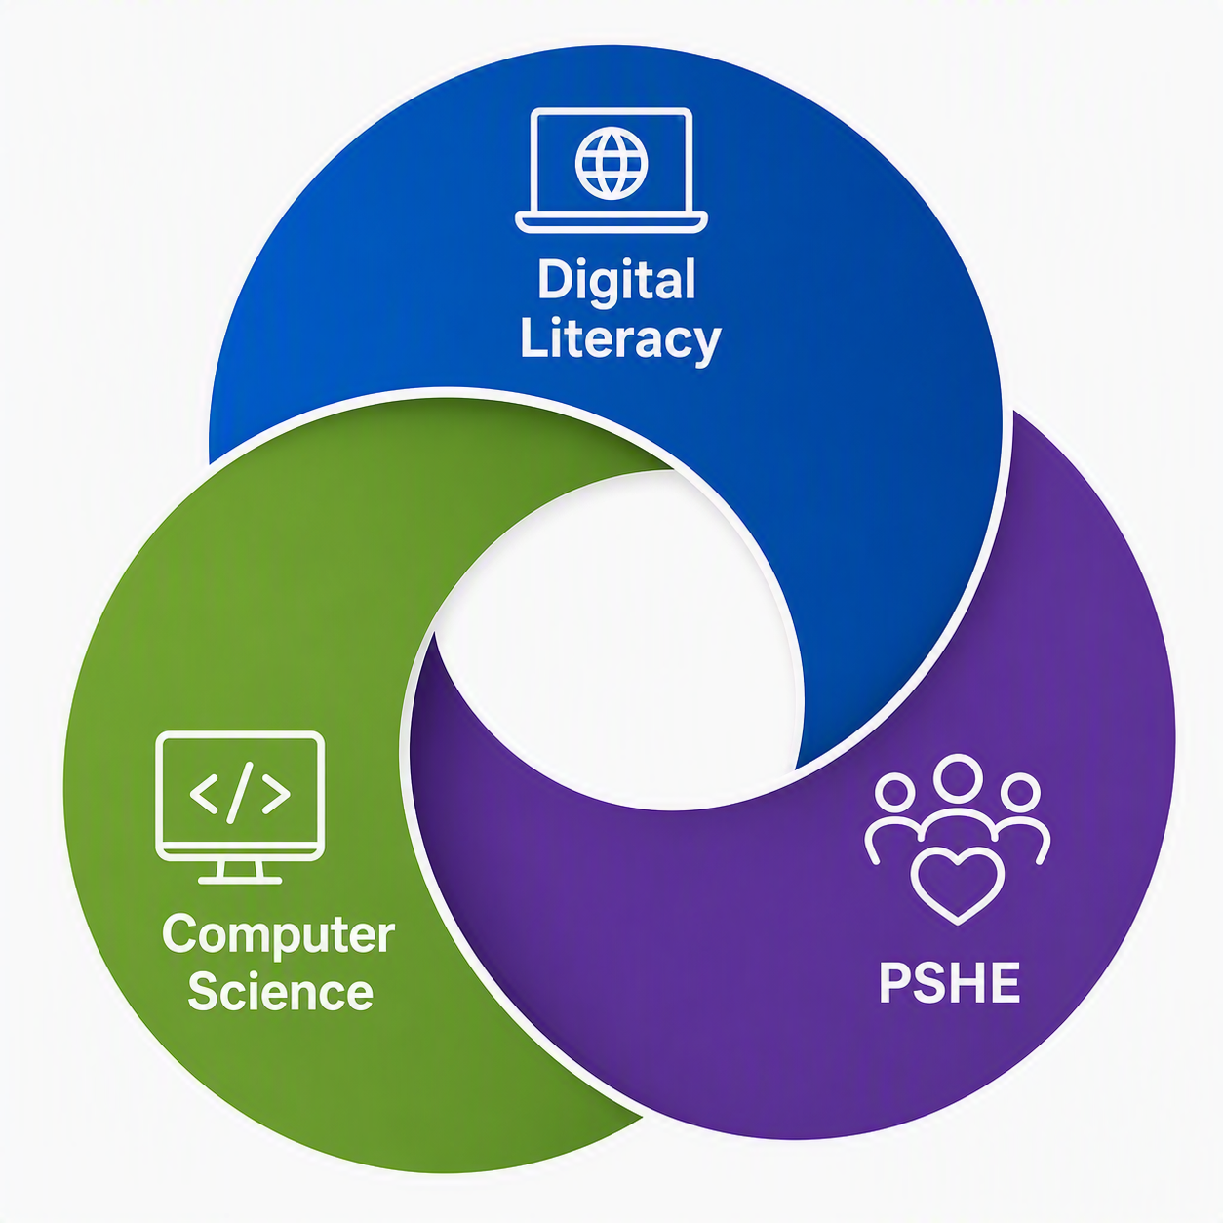
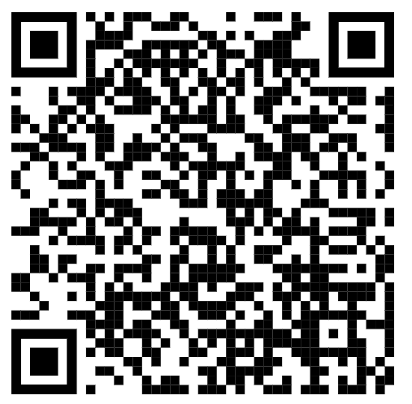
Digital Health, Resilience & Skills Curriculum
Aims
Foster healthy digital habits and resilience to navigate online challenges while safeguarding mental health.
Empower students to develop the resilience needed to overcome setbacks in the digital world.
Equip students with essential digital skills for academic success, future careers, and responsible online engagement.
Notes:
Simon

Slide 6
Digital Literacy Lessons
Students will learn how to use Office 365 (including email etiquette) and all other school applications
Students will learn how to make effective notes and use their Digital Textbooks and resources.
Students will learn how to use their devices effectively and responsibly
This provides a safe place to ask any question they have about technology
Students will learn how to Touch Type
Notes:
Simon

Slide 7
Digital Literacy – more detail
Tools: Outlook, OneNote, Teams, Excel, Powerpoint
Your identity online: exploring the impact of social media and the attention economy; whose data is it?
Healthy use of technology, sleep, eye care, balance.
Creativity: Canva, Stop Motion
Fact or fiction: what information can we trust
Developing effective revision techniques, responding to feedback

Slide 8
Digital Literacy Rotation
 | Autumn | Spring | Summer
7A1 | CS | DT | DL
7A2 | DL | CS | DT
7A3 | DT | DL | CS
7B1 | DL | CS | DT
7B2 | DT | DL | CS

Slide 9
Learning using Technology
Device management is active whilst in School between 8.30 to 15.30
Why do we need it…
To provide Wi-Fi and Filtered Internet
To 'push out' apps required for learning and paid for by the College
To support students who forget their passcode or misplace their device.
To limit distractions in lessons such as notifications, messaging, Airdrop
To prevent access to social media, games, and non-age appropriate material
A key study found that it can take students up to 20 mins to refocus when their learning is distracted.
UNESCO’s 2023 Global Education Monitoring Report ‘Technology in Education: a Tool on Whose Terms?’
Notes:
Simon - The device does need a Wi-Fi connection for apps to come back (a restart at home once connect to Wi-Fi will make apps reappear)

Slide 10
Digital Support for Students
If students require additional support with devices they can visit the IT Office between 07:30 and 18:00
For students who forget their device or cannot use their device due to repair, we have spare iPads.
Students are also able to report problems or request assistance by emailing it@jcg.sch.je
Notes:
Simon

Slide 11
Apple ID and App Store
All students will remain signed in with their School Apple ID​
200GB Free Storage
School-based applications such as Apple Classroom and Schoolworks require students to be logged in with their school Apple ID.
Can be used for App and Device backups.
The most common apps for streaming are provided for students in their JAMF student app: Netflix, BBC iPlayer, Amazon Prime Video, Disney+, iMovie.
Duolingo is also there. Please email IT@jcg.sch.je for requests.
Apple do not allow downloads from the App store using the school Apple ID
Notes:
Emily - This is necessary for School works and apple classroom) and until they are 13. once they are 13 they can freely switch between their apple ID’s

Slide 12
Parental Controls
Use JAMF Parent which is a Free app – iPhone, iPad, Android
Allows parents and Guardian to remotely manage their child's device beyond the school day.
Restrict app use, add time limits, screen time, lock screen
Link to setup guide in Year 7 Booklet.
There will be a hands on parent support session on Tuesday 6th October from 5:30pm-6:30pm in Hectors.
Video Setup Guide : https://www.youtube.com/watch?v=-OYyk0lbP-o
Notes:
Emily

Slide 13
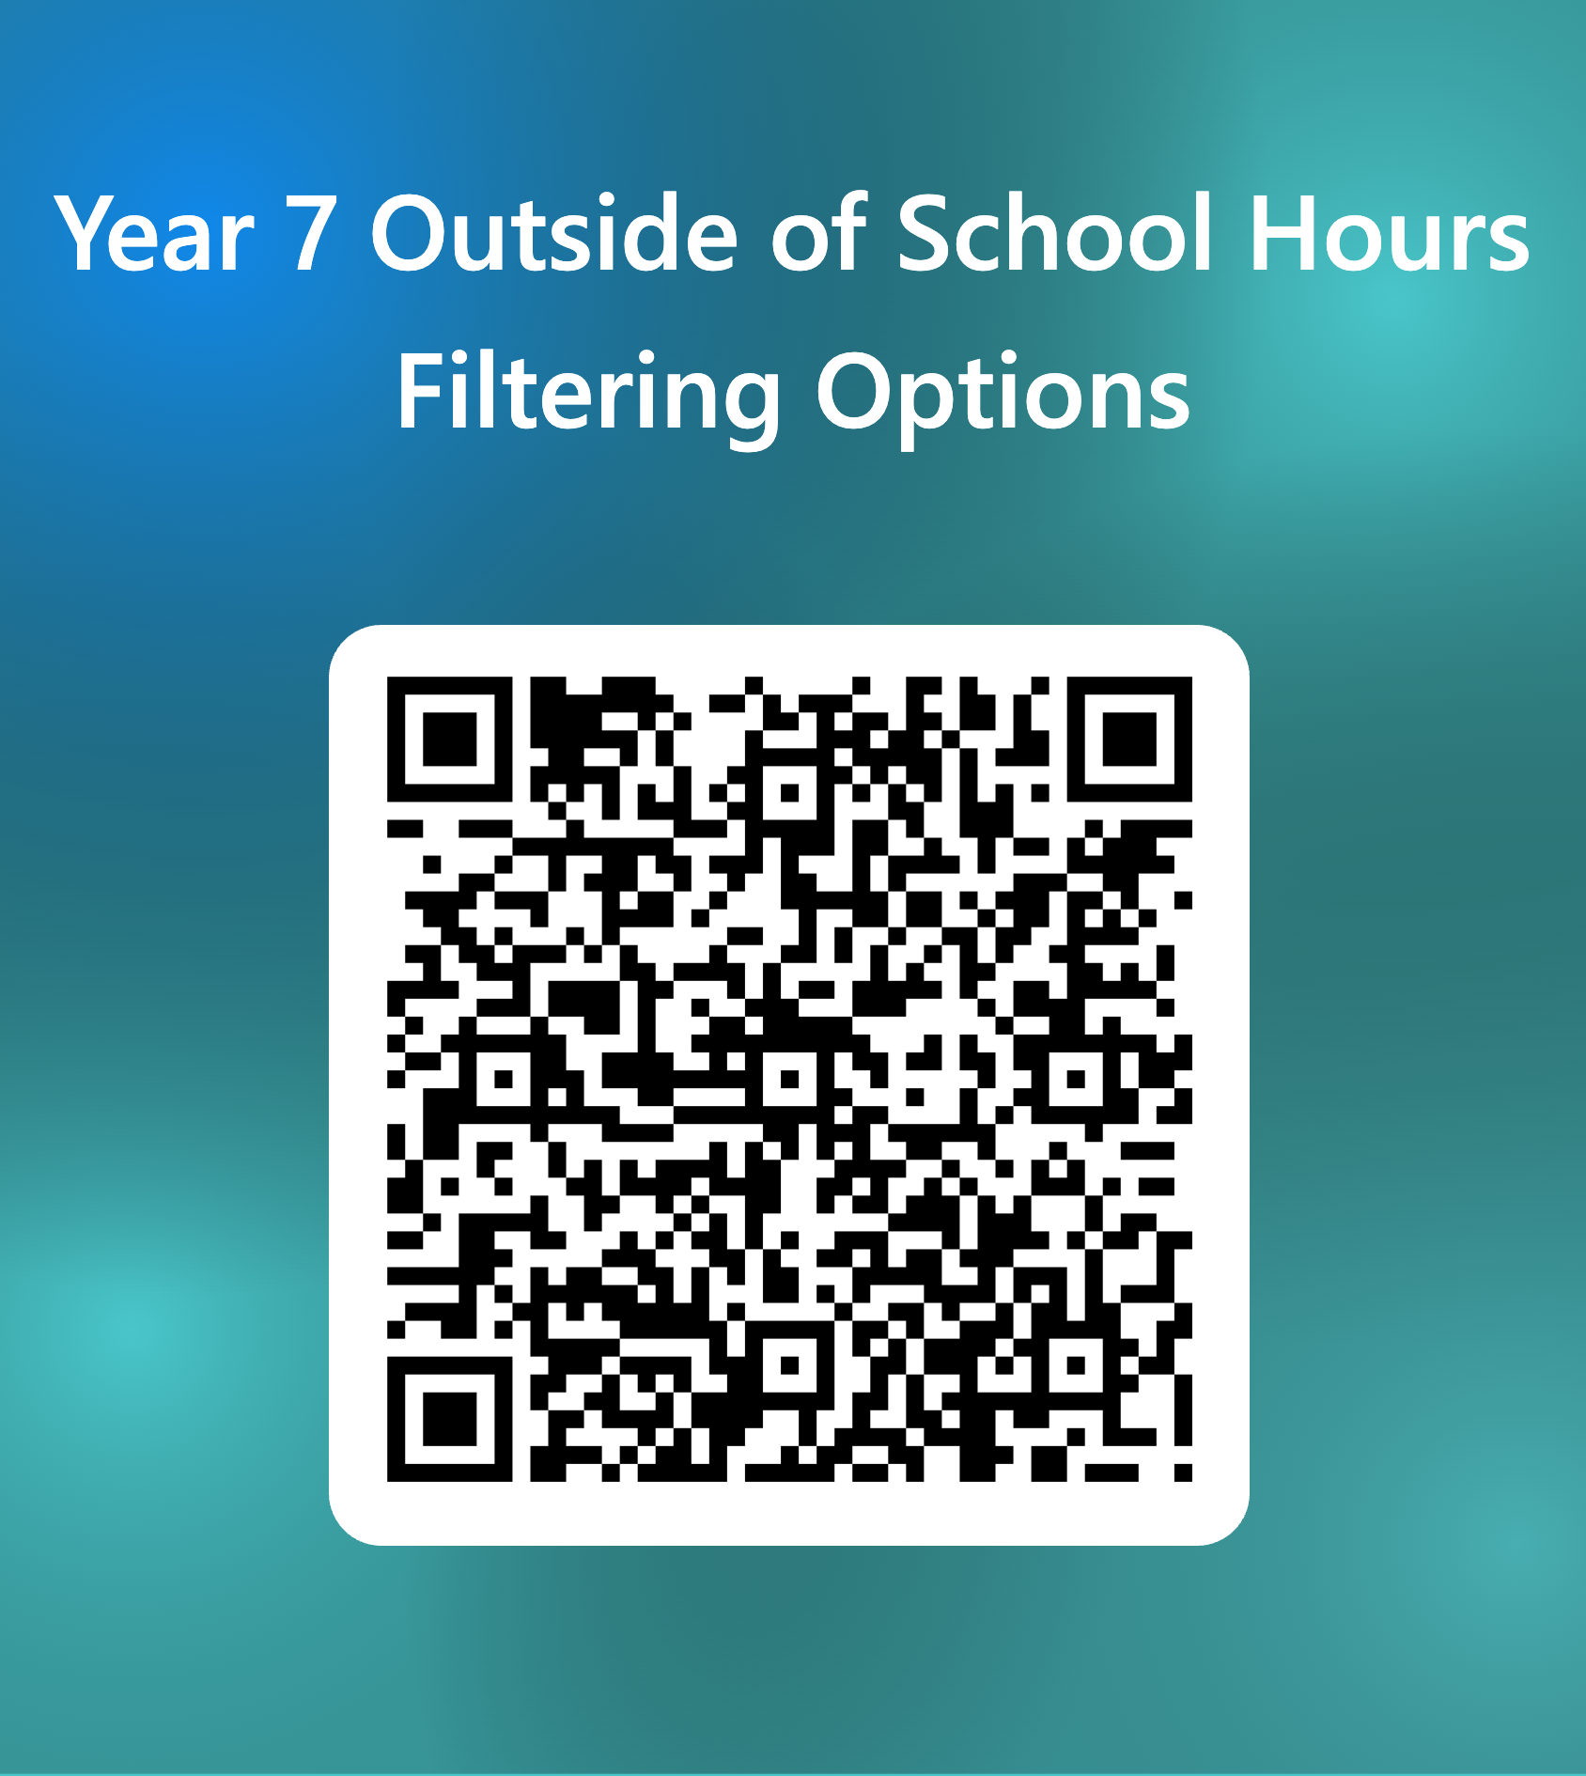
Internet Filtering at home
Lightspeed parent portal app
Filtering restrictions
Pause internet access
View internet activity.
How to sign up is on the Device Management page of the school website:
https://jerseycollegeforgirls.com/jcg/college-life/parents-tech-support/device-management
Option 1 - School filtering extended beyond the school day - in place 24/7 (only Apps for learning and internet filtered as at school)
Option 2 – Less restrictive filtering, blocks all adult/mature content and social media while allowing access to streaming platforms such as Disney Plus and Netflix.
Option 3 - No filtering provided but access to the internet is managed by Lightspeed parent portal.
Notes:
Emily

Slide 14


Screen Use and Eye Health
Take a 20 second break
Every 20 minutes
Look at something 20 feet away
Notes:
Emily
There is various information available online regarding screen time, but screen time is a rather vague idea by itself when we don’t also consider the type of content being accessed via a screen. Its not even as simple as saying educational and non-educational screen time. A good way to look at it is on more of a scale, with at one end of the scale is screen time being used to support educational activities and other positive supportive activites such as using screens to display a recipie or a video guide on how to make an origami swan. Then on the other end of the scale is content such as social media and other age in-approrite content with things like streaming netflixs somewhere in the middle. What we aim to do is encourage students to start creating healthy habits in regards to screen time.
When it comes to using screens for any length of time whether this is a device for learning or the TV at home, we need to avoid eye strain, this can happen when we focus on any 1 object for long period of time. A good habit to get into is the 20:20:20 rule, meaning you should look away every 20 minutues at something 20 feet away for at least 20 seconds. Another factor which can contribute is how far away the screen is. An easy guide for this is 1-2-10 rule. Mobiles should 1 foot away, laptops 2 feet away and tv’s should be 10 feet away.
Another area we should touch on is blue light, research has found that the level of blues light exposure from screen is significantly lower than that of natural daylight and therefore is very unlikely to impact eye health. It may however, it may hinder sleep if you are exposed to any source of clue light coming up to bed time. To mitigate this, you should do a couple of things. First you should make sure any devices you are using have Night Mode, on iPads and iPhones, this is called Night Shift, which automatically shifts the colors of the display to the warmer end of the spectrum after dark. Secondly you should look at incorporating limited device usage in the hour before bed to items such as audio books or podcasts.
Digital Distractions are a large part of using technology and it is essential that we work with our students about techniques that can be used to manage these. As you may know one of the biggest distrations is notifications. When you get a notification are you compelled to check your device? It is siencifically proven that the notifications you get release a dompamine release which is why this is happens. By understanding this we are able to take control of technology and these distractions and stop letting technology control how we interact with them. To manage this, we can look at stopping notications via do not disturb and focus features on their devices.
While current research shows that handwriting better engages in sensory and motor processing which in turn support xxx to memory, it does not differ between writing on paper or screen. While writing on screen does not feel as tactile, with the addition of paper like screen protectors we can achieve the same handwriting feel. This means students have the option to hand write directly onto their iPads meaning work is safely saved and easily accessed again when needed.

Slide 15
Acceptable Usage Agreement
The AUA can be found on the College website within the Safeguarding and child protection policy.
Expectations about safe and appropriate online behaviour and use of devices.
This was signed as part of the admissions process.
We will go over the AUA during school time to cover the key expectations
Notes:
Simon

Slide 16
Misuse of a Device
Misuse of technology generally falls within our Supporting Student Behaviour policy. If you have any concerns about your daughter's potential misuse of technology please contact your daughter's Form tutor in the first instance.
Notes:
Simon

Slide 17
FAQs
What happens if my child’s device runs out of battery? – every classroom is equipped with battery packs for students to use during lesson time. It is, however, each student's responsibility to come to school ready and prepared for lessons. This includes with a charged iPad and pencil.
What happens if we go abroad? - students need to pop into the IT office during the week before in order to check that their Authenticator app works. For subsequent visits they simply need to complete a form which is in Tutor notices.

Slide 18
Student Welfare and Progress
Natalie Hopkins
(Assistant Headteacher)
Notes:
Good evening and welcome. My role as Assistant Headteacher is to oversee student guidance, both academically and pastorally. This evening I want to reassure you about two things: firstly, how we support your daughter's wellbeing and happiness; and secondly, how we work with you to help her thrive academically.
The move to secondary school is exciting, but it's also a significant transition. Even in a selective school where students are capable and motivated, we know that success depends on much more than academic ability.

Slide 19
Student Welfare
Notes:
Before students can flourish academically, they need to feel safe, connected and supported. Our pastoral systems are designed around this principle.

Slide 20
Year 7 Wellbeing Worries
Getting lost
Making friends...
...Changing friends
Managing homework
Teachers' expectations
Navigating social media
Exploring identity
Notes:
These are some of the most common concerns we hear from Year 7 students.
Getting lost: Usually solved within a week.
Making friends: Most students arrive knowing only a handful of people, some even less, but having teachings groups and different form groups, as well as attending extra curricular clubs, will help them to make lots of connections with others.
Changing friendships: Perhaps the biggest challenge of Year 7. Friendships are fluid and that's normal. Please encourage your daughters to speak to new people and not to panic is groupings appear to change.
Homework expectations: Students are learning organisational skills as much as academic content. Most students will already have experience with homework completion and we slowly build up the amount given to help with organisation. The library is also open after school and students are welcome to work there.
Social media: Many friendship difficulties now continue beyond the school day. Prevalent use of mobile phones and social media can mean that friendship issues increasingly follow children home, so parental oversight remains incredibly important.
A useful reassurance:
Parents often worry when their daughter says 'I have nobody to sit with' or 'everyone else has lots of friends'. Usually this reflects one difficult moment rather than the reality of their whole week.

Slide 21
Advice from our Parents and Carers
Support your child's wellbeing through:
Early nights
Exercise (including dog walks, cycling to school etc.)
Family meals (opportunity to talk)
Routines
Family time
Pets
Handing in devices (e.g. 2030)
Keep telling them you love them
Giving children space / a break from questions
Sharing the best things that happened today...
Goodnight chat (with each child individually)
Notes:
I love this slide because the advice comes not from teachers but from parents who have travelled this road before you.
Sleep
If I could choose one factor that makes the greatest difference to wellbeing and learning, it would probably be sleep. Year 7 students generally need 9-11 hours of sleep per night. Good sleep supports memory, concentration, emotion regulation and behaviour. It is also good practice to avoiding screens before bedtime because they can disrupt sleep.
A child getting seven hours of sleep may technically be functioning, but they're unlikely to be learning, concentrating and regulating emotions at their best.
Family meals
The value isn't really the meal itself; it's the opportunity for conversation and connection. Chats while you're doing something, chopping carrots, sharing a meal, driving to school, tend to allow for information sharing in a more informal and natural way and you might find that you get more than a grunt!
Device hand-in
Many experienced Year 7 parents talk about devices being handed in at 8.30pm or a similar time. The exact time matters less than consistency. It's much better to get this established now so that by the time they are fully fledge teenagers it's just part of the muscle memory each evening.
Tell them you love them
As children move into adolescence, they often appear to need us less. In reality, they still need us enormously, even when they communicate that in unusual ways.

Slide 22
Advice from Dr Charlotte Clarke
Supporting good behaviour without compromising excellent relationships
Positive noticing (drawing attention to some of the many good things our children do, which make us proud)
'I notice that...' (a non-confrontational way to draw attention to conduct that needs to be questioned or challenged)
'That may be true, and yet I need you to....' (a script for acknowledging and validating what a young person is saying whilst ultimately redirecting them to an expectation that needs to be met)
Notes:
Many parents tell me that they want to maintain warmth and strong relationships while still setting boundaries. These strategies can be very helpful.
Examples:
Positive noticing
Instead of:
"You never organise your bag."
Try:
"Well done for getting your bag ready this morning."
"I notice that..."
Instead of:
"Why is your room such a mess?"
Try:
"I notice that the clothes haven't been put away yet."
"That may be true, and yet..."
Example:
"That may be true, and yet I still need the phone downstairs before bedtime."
It acknowledges feelings without surrendering the expectation.

Slide 23
Student Guidance Systems
Form Tutor
Head of School / Assistants
Special Educational Needs Co-ordinator
Teaching Assistants – ELSA work
Building Positive Relationships
Counsellors – Elif Mossop and Fi Daniels
School Counsellors Web Link
Buddies
Peer Mentors
Any adult in College
Notes:
No child should ever feel that there is only one person they can turn to.
Here at JCG students are told that they can speak with any adult member of staff and they do. But, there are a few people that it's worth you being aware of so that you can help to direct them:
Tutors are first point of contact.
Heads of School oversee wellbeing and academic progress
SENCO and learning support team are there for when students need a little more support to access their learning.
Our Counsellors ensure provision throughout the week and do a great job of providing a valuable and supportive service.
All students will also have a buddy and they have access to peer mentors in Year 12 who are trained to support younger students in a variety of ways.
Our most important message to students is that if you're worried, tell any trusted adult. We can always make sure the concern gets to the right person.

Slide 24
Working in Partnership
What our Wellbeing Policy asks of parents:
Working in partnership with the College to cultivate the wellbeing of your children
Giving due consideration to advice, from the College, about how the wellbeing of your children might be best supported
Providing feedback to the College on how the wellbeing of your children might be best supported
Attendance
Attendance letter, outlining procedures for supporting attendance, sent to all parents and carers in September.
Notes:
The best outcomes happen when school and home work together.
You might say:
"Parents see one side of a child; school sees another. Neither of us has the whole picture."
Examples:
A student may appear happy at home but quiet in lessons.
A student may appear confident in school but anxious at home.
"The earlier we know about a concern, the easier it usually is to resolve." You can get in contact with tutors in the first instance so that we can work together to help your daughter thrive.
Attendance matters because every missed day represents missed learning, missed friendships and missed routines. Where attendance falls below an expected level you will receive correspondence from us so that we can find out how we can support you and your daughter.

Slide 25

Support Beyond College
The College's role:
Signposting
Making referrals
Working alongside other professionals
Leading an Early Help 'team around the child'
Support Outside of College Web Link
Notes:
Sometimes families need support beyond what school can provide directly.
Where this happens we might:
Signpost you to an agency who would be able to provide this support
Make Referrals to the agencies on your behalf to share information and get the help in place
Lead on early help to make sure that everyone is sitting around the table together and making sure that your daughter is at the centre of decisions that we are making.
Seeking support isn't a sign that something has gone wrong. It's often a sign that families are dealing with challenges proactively.

Slide 26
Student Progress
Notes:
I'd like to turn now to academic progress and how you can support your daughter as learners become increasingly independent.

Slide 27
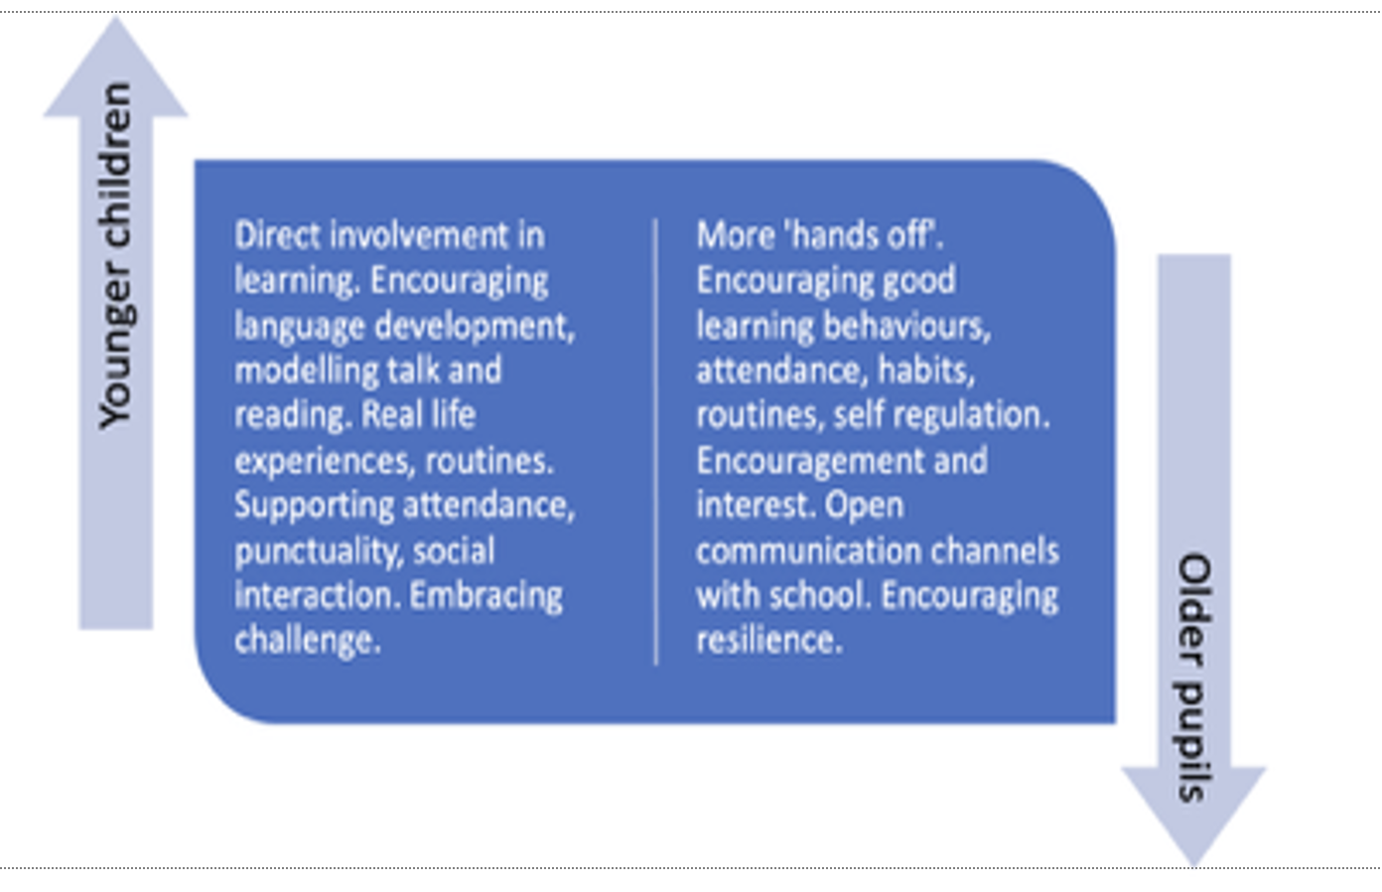
Your Changing Role as Parents
Notes:
The transition from primary to secondary often requires a shift from manager to coach.
Examples:
Primary:
Checking every piece of homework.
Packing bags.
Secondary:
Asking questions.
Encouraging planning.
Helping children solve problems.
We don't want students to be dependent on adults but for them to move to gradual independence supported by adults. They need support in problem solving so that eventually they can do this either on their own, or by actively seeking support.

Slide 28
Healthy Learning
Be a scientist about your own behaviour; notice which elements affect you most when they're depleted. Then build some better habits to increase your SHED fuel and, as a consequence, fuel your brain. Sara Milne Rowe
Sleep
Hydration
Exercise
Diet
Notes:
Students often think success comes from motivation. In reality, success is often about habits.
Sleep
As I mentioned earlier 9-11 hours recommended.
Hydration
Even mild dehydration can affect concentration. Children are notoriously bad at drinking enough – unless they're in my lessons...
Exercise
A brisk walk, cycling to school or playing sport all help learning and mental wellbeing. Team sports in particular also help students to experience comradery and a sense of belonging.
Diet
The brain uses around 20% of the body's energy. It needs fuel; regular and nutritional, in order to be able to make good decisions, concentrate and navigate relationships
Parents can sometimes look for complex study techniques when the biggest gains come from enough sleep, movement, water and regular meals.

Slide 29
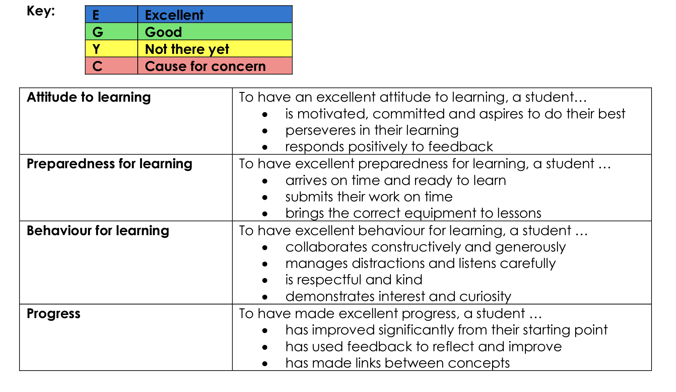
Tracking Student Progress
Notes:
"We use progress tracking to identify strengths, celebrate success and spot concerns early."
It is important to say that:
Progress is a journey. It doesn't always look exactly as you want it to.
Small dips can occur during transition. As with all changes in life, sometimes things can slow down before they speed up again as we adjust to our new surroundings
One assessment rarely tells the whole story. Everyone is entitled to a bad day and you don't need to be immediately concerned if there is a slightly lower than anticipated assessment result.
We're looking for patterns over time rather than perfection in every piece of work.
You will receive 2 periodic reports and one full report each year. There is reporting in the areas on the slide and teachers will use the letters in the Key to state how a student is working. Excellent, is obviously just that, Good means that students are doing what they need to do to make progress, not there yet indicates room for improvement and cause for concern is relatively rare but should never come as a surprise as the Head of School will have already been in contact with you about emerging concerns.

Slide 30
The Excitement of Adolescence!
'The whole of adult society is built on millions of adolescent stories...In childhood, we establish the basics – who we can trust, what actions lead to good and bad outcomes, how we’re supposed to behave. But it is in adolescence that we truly come alive, that our experiences really start to shape the person we become.'
Dr Lucy Foulkes, Coming of Age: How Adolescence Shapes Us
Notes:
"It's easy to focus on adolescence as a period of risk and challenge. In fact, it's also a period of tremendous opportunity."
"Dr Lucy Foulkes reminds us that adolescence is when experiences begin to shape who we become as adults."
"Over the coming years your daughters will become more independent, more confident and more self-aware. There will be occasional bumps in the road, but that is entirely normal. Our commitment is that we will know them, support them and work with you to help them flourish."
"Thank you for entrusting them to us, and thank you for working in partnership with us."

Slide 31
Additional Information

Slide 32
Attendance for Achievement
Consistent attendance is crucial not only for academic success but also for developing essential life skills, such as time management and responsibility, and contributes to a more positive school environment. It is key to each student's sense of belonging.
DfE research found that pupils who performed better both at the end of primary and secondary school missed fewer days than those who didn’t perform as well.
Exam week – w/c 24th May 2027 (week prior to May half term)

Slide 33
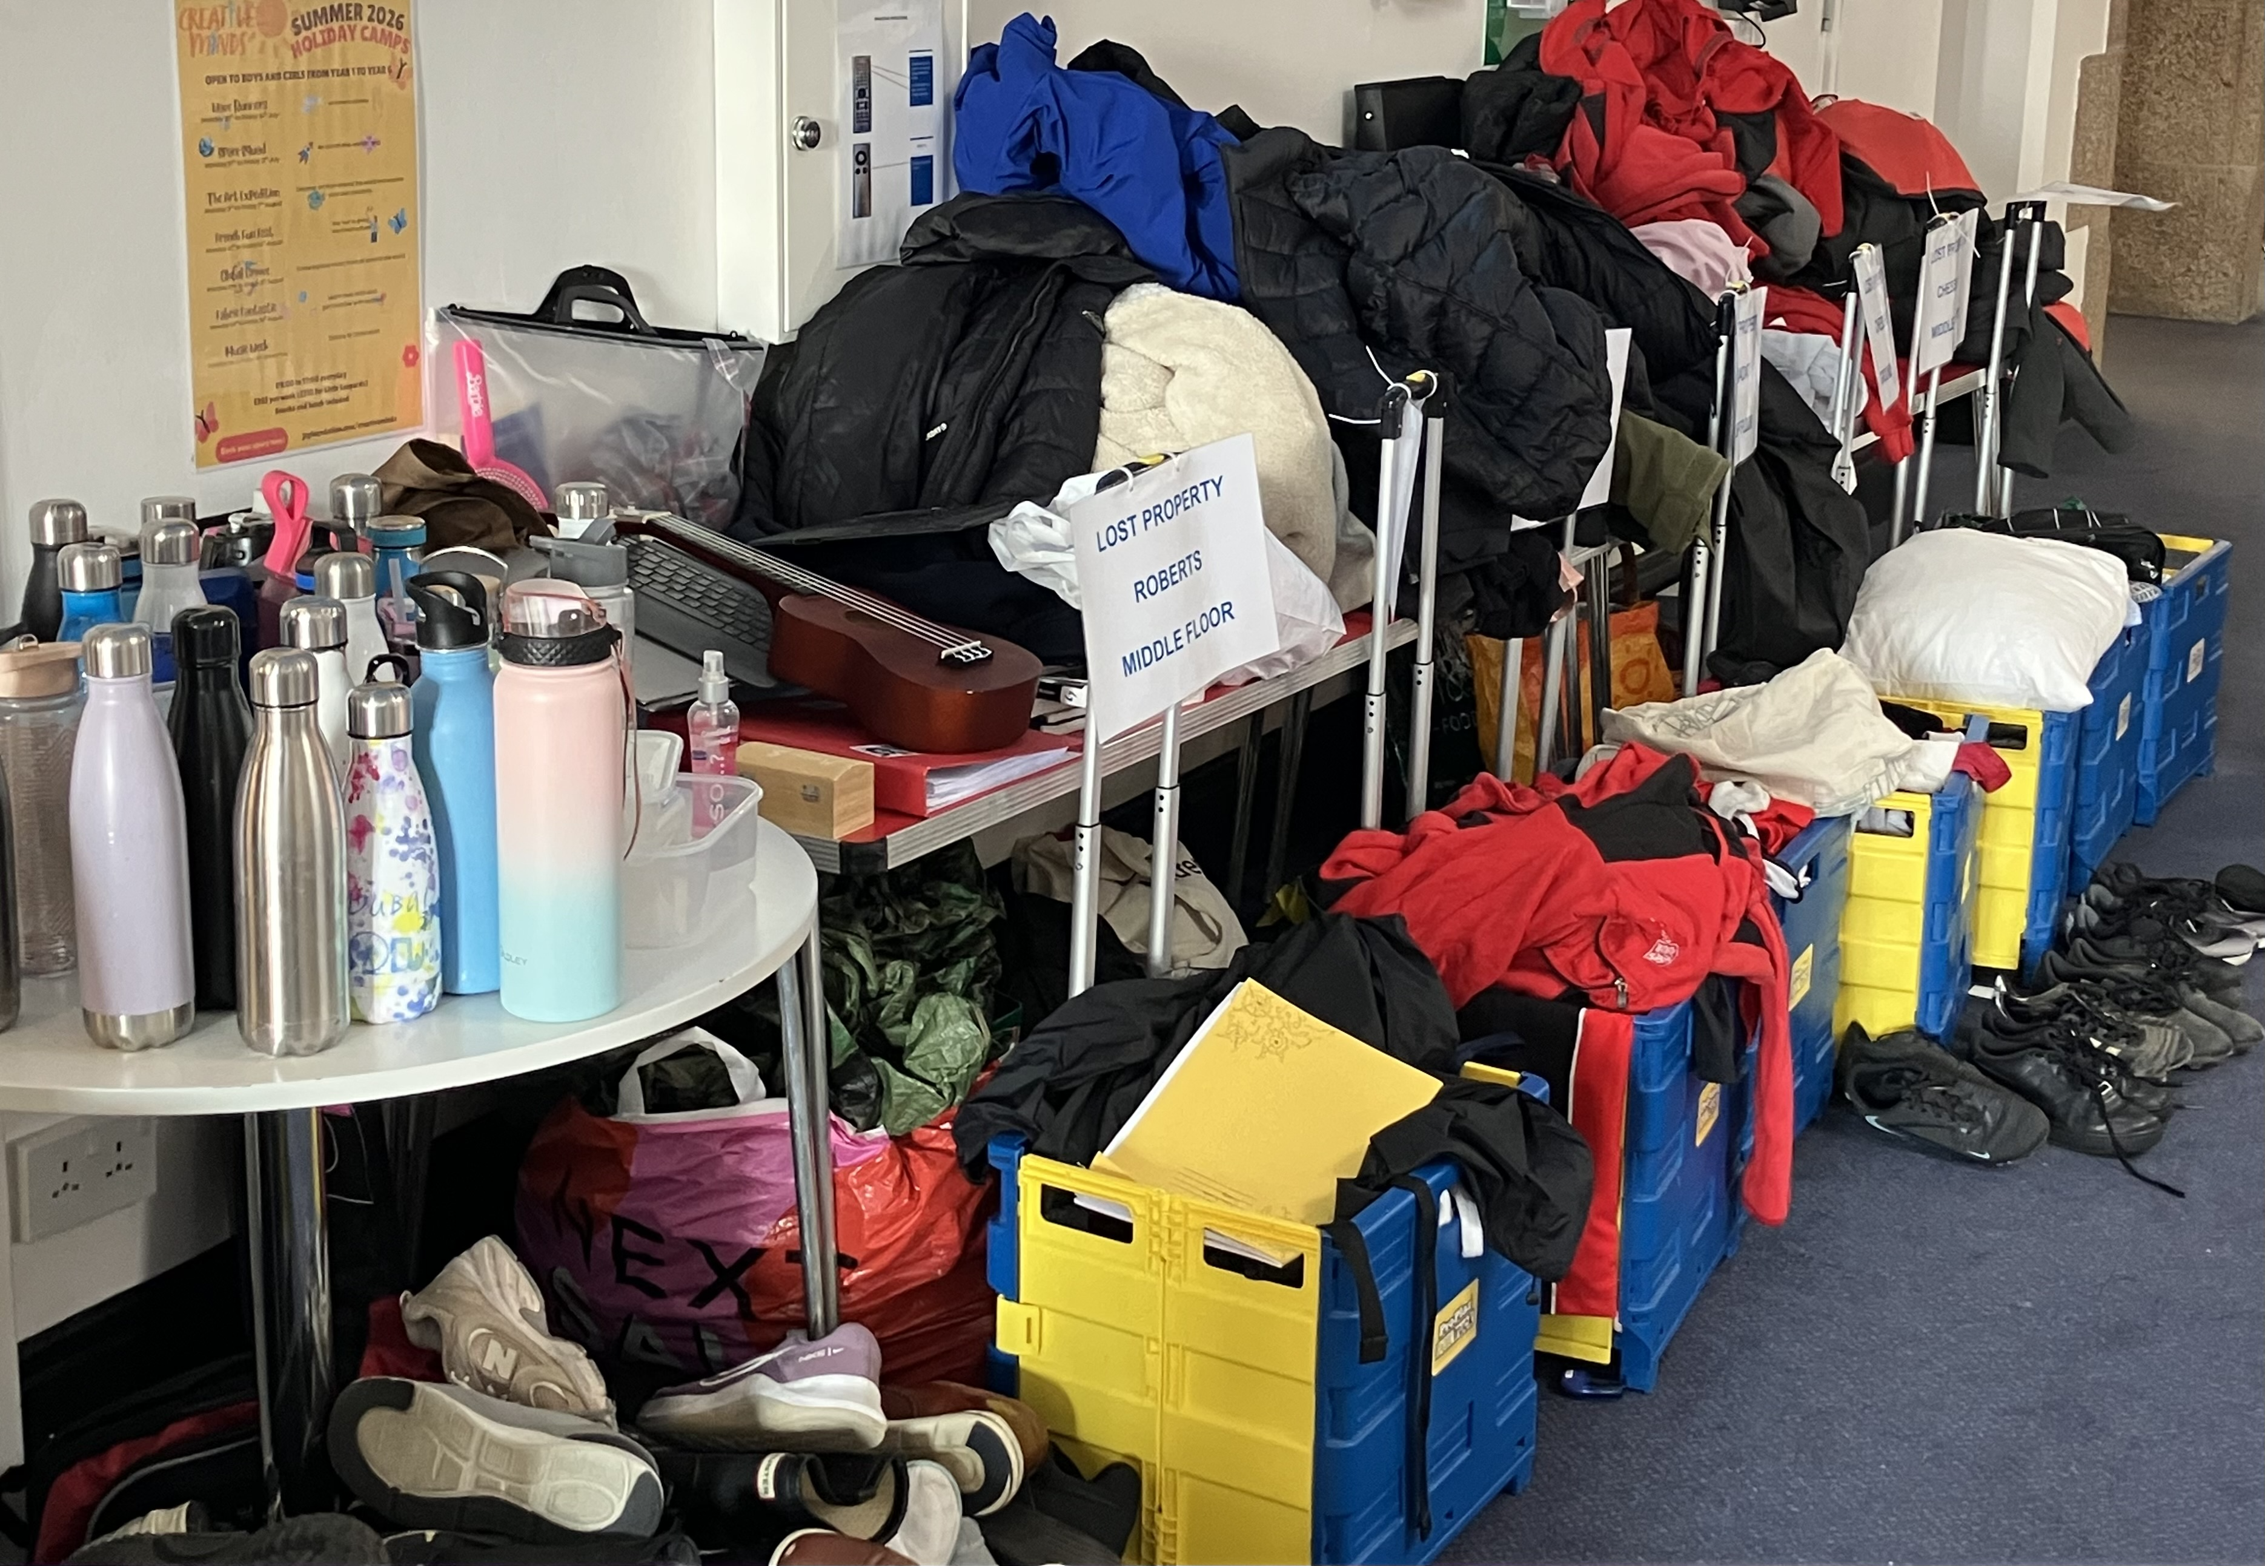
Student Belongings

Slide 34
Communication
Weekly Newsletter
E-mails from Principal / SLT / Heads of School
Satchel One (Show My Homework)
Notes:
As Mr Milner as touched on, here at JCG, we believe that effective communication between home and the College – is one of the foundations that underpins a good working relationship between College and our families. We are a busy school with lots of exciting different things happening.
As such, we have various forms of communication to keep you updated on events and notices.
Weekly Newsletter – Contains whole school and generic information, as well as year group specific information and calendar reminders and key dates
Letters (via e-mails / in touch) – from Mr Howarth or other members of our Senior Leadership Team or myself about specific Lower School matters.
Everyone should hopefully have logins to access their daughters Satchel One account soon, if they have not received these already – here you can see what homework has been set, in which subject, by which teacher, any resources that might be attached, the detail and the time that it should take.
Additionally, everyone should also have a parent login for the SIMS App so that they can see the achievements that have been awarded throughout the week to your daughters and also view attendance statistics.
You will find that form tutors and myself will be in regular communication depending on whether or not your daughter is accessing any support at a particular time or to keep you updated on her progress and well-being – we might therefore be in contact via e-mails or phone calls.
As much as we hope that you are open to communications from us, we also welcome communications from yourselves – we want to encourage open dialogue between parents and home so that we can meet the needs of our students and support your daughters in the best possible way. We genuinely feel that working in collaboration with parents is the best and most effective way to support all our students.
Whilst we appreciate that parents may have worries about issues or concerns that are reported to us as a school being raised directly with your daughter, we want to address these concerns appropriately and to bring about a positive outcome. We therefore ask for openness to trust us and working with us to make a judgement about the appropriate course of action for support.
At times we might have discussions or communications where there are sensitive issues that are raised regarding support for your daughter and understandably, this may cause heightened emotions. At these times, we would ask you to remember that we are here to support your children and your families and therefore that all contact and communication recognises that.
We also aim to send out a termly Lower School Newsletter to share celebrations and success stories of our Lower School students and other Lower School activities as well as what we have been covering in our Tutor Programme and assemblies, so please do keep me updated about your daughter’s achievements outside of school.
At this time, your daughter may be feeling a little apprehensive about one or some of her groupings:
Your daughter will be in a House / Form Group, Teaching Group, PSHE Group, Friday Afternoon “Wild Friday’s” Group and Maths set, which will be streamed later in the Autumn Term. She therefore will have 5 different groups, and 5 different opportunities to meet other students.
If she is feeling unsure or unsettled at this time, please reassure her, that it is still early days, many others will be feeling the same. Please e-mail her Form Tutor to make them aware so that they can keep an eye on her, and we ask all parents, of all our older students to allow a three week settling in period to new groups before any changes are considered.

Slide 35
Achievement Marks
Supporting Student Behaviour Policy: https://jerseycollegeforgirls.com/jcg/about-us/policies-and-procedures/supporting-student-behaviour-policy
30 = Bronze certificate awarded by tutor
60 = Silver certificate awarded by tutor
90 = Gold certificate awarded by Head of School in lower/upper school assembly
120 = Platinum certificate and Amazon voucher presented in whole college assembly by Vice Principal (TR)
Notes:
At JCG, we love to celebrate the success of our students, and share this success with you as parents.
Students are awarded achievement marks in lessons and around the school, for their contributions to the wider community and for other accolades by all staff working in the College – not just teachers, ladies in the office and the librarian etc.
These achievement marks are communicated with home via the SIMS Parent App where you can see who has awarded the achievement mark, in what lesson, what for – and any other additional comments.
We monitor these achievement marks throughout the year, and as the students reach the milestones shown in the slide, they are awarded further with certificates, letters and even vouchers as recognition for their efforts.
Last year we awarded nearly 33,000 achievement marks across the school.
In Year 7 alone, nearly 8,000.
We understand that despite everyone’s best efforts – there are also occasions where things don’t necessarily go to plan, or students might struggle to meet expectations.
With this in mind, we also issue behaviour marks at College.
These can be issued in lessons and around school for lack of equipment, improper uniform, homework issues, lack of effort and other behavioural concerns. To receive the occasional behaviour mark is not necessarily of concern – it is more to highlight to students and make them aware that there needs to be an improvement.
You would not necessarily be contacted in this instance, and they do not appear on the SIMS Parent App – if your daughter’s behaviour or lack of effort is of concern in a particular lesson or subject – the subject teacher, or their head of department of faculty would make contact with you directly.
If there seemed to be a pattern of poor decision making across a variety of subjects or areas of the school, then as the Head of Lower School – I would then have an involvement to work with their Form Tutor to identify strategies of support to help your daughter consider her actions and make more positive contributions, which may involve being placed on a supportive Stage 1 report to have regular check-ins with the student and help to guide in making positive decisions.

Slide 36
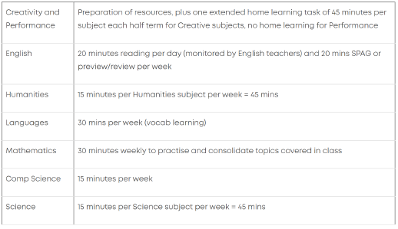
Home Learning
Notes:
There is more on this in your booklet, but as a quick overview.
Your daughter will not be set any homework from subjects other than Maths and English until 2nd October… and breathe!
From now until then, she will be set 30 minutes of maths learning and practice through an application that she will become familiar with called Century Tech, and 20 minutes of reading per day.
What she will be issued with, is a Pupil Passport – by her Form Tutor.
This contains a series of activities such as finding locations, joining clubs, meeting certain people – to help her get to grips with where things are, how things work and feeling more integrated within the community.

Slide 37

Proactive Measures to Promote Well-Being
Year 7 off timetable on Thursday afternoon (Outdoor Education)
Buddy Activities
  Tutor Programme
  Lower School Assembly
  PSHE Lessons (Mrs Mynes)
  Outdoor Education (Ms Powell)
Notes:
It’s really important to us as a College that we don’t treat student well-being as an aside to what we do, and also that we don’t just react when there seems to be issues.
Rather, we plan ahead and we are proactive in our approach to promoting positive well-being and mental health.
Also, we plan for mindfulness activities in our tutor programme. We give opportunities to slow down, to pause and reflect.
We take note of National Weeks and events and consider these in our tutor programme as well as reminding students that Form Time is a safe space to open up and talk should they need to.
In our assembly programme we welcome the work of external agencies, such as “You Matter” to talk to the girls on issues such as body confidence and image. And, over the course of the next two years we will be exploring many other aspects of well-being in the hope that we are encouraging the students to develop resilience to manage and self-regulate when potential issues arise in the future.

Slide 38
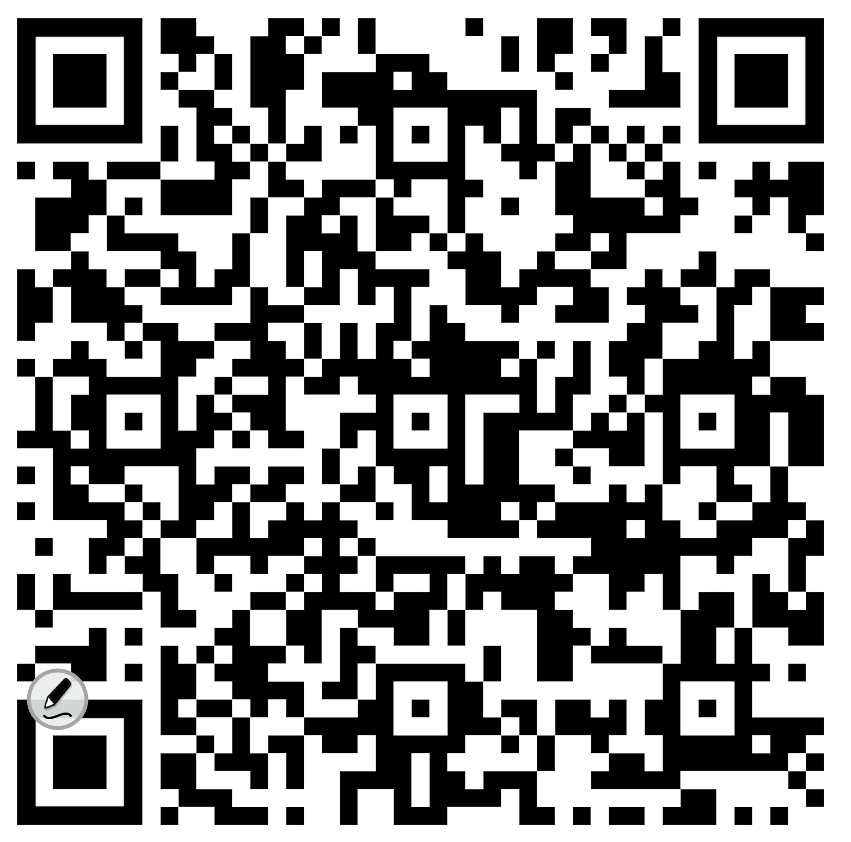
Year 7 Parent Handbook 2026-27

Slide 39

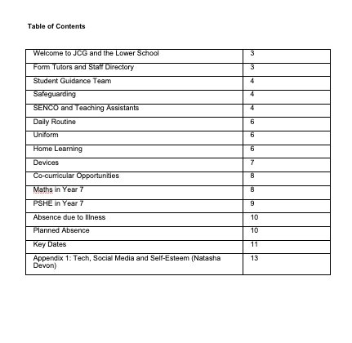
Notes:
As you arrived, you hopefully were given a booklet, a handbook to Lower School Life at JCG.
A lot of this information is available on our website, which if you haven’t viewed yet, I would recommend having a little look to read our visions for our students and familiarise yourself with the various content available.
But, this booklet, hopefully keeps it all in one place, that is easy to digest, not too overwhelming and can help you to support your daughter over the next few weeks as she settles in.

